Slide 1
Linux Operating System
Practical Guide to Linux Commands, Editors, and Shell Programming, A (3rd Edition) by Mark Sobell
Unit 1: An Introduction to Linux
Chapter 2: Installation Overview
Copyright © 2012, Fred R. McClurg, All Rights Reserved

Slide 2
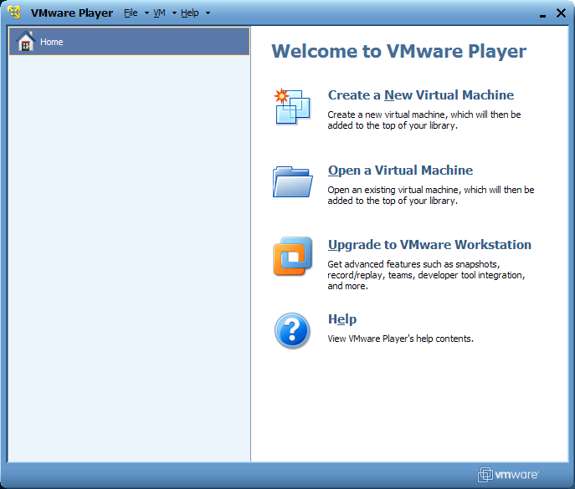
Create New Virtual Machine

Slide 3
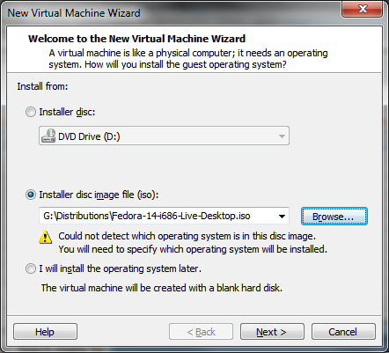
New Virtual Machine Wizard

Slide 4
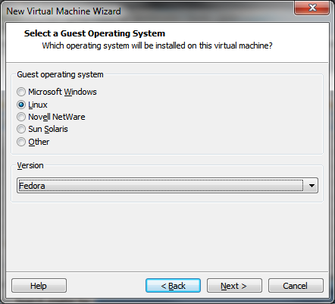
Select a Guest Operating System

Slide 5
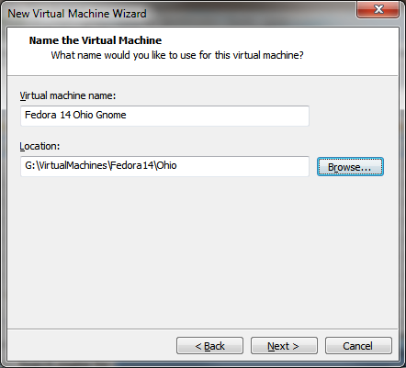
Name the Virtual Machine

Slide 6
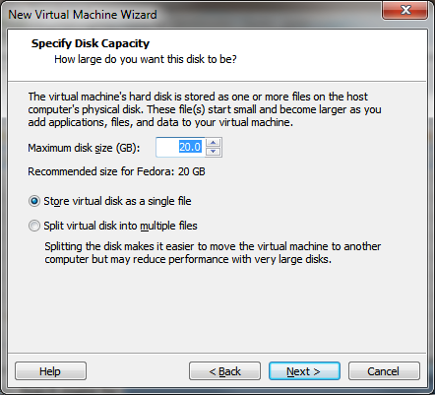
Specify Disk Capacity

Slide 7
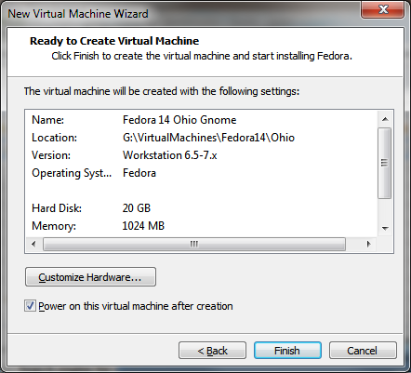
Ready to Create Virtual Machine

Slide 8
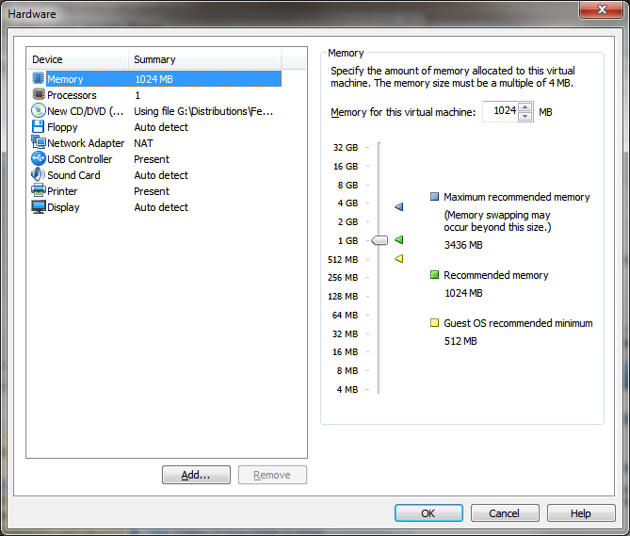
Hardware Memory Summary

Slide 9
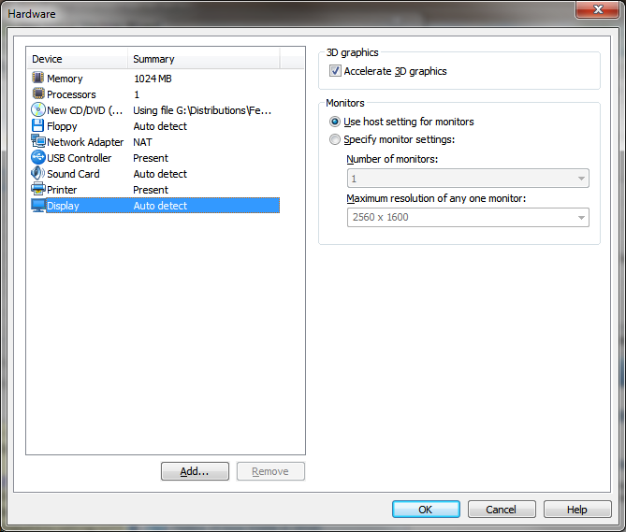
Hardware Display Summary

Slide 10
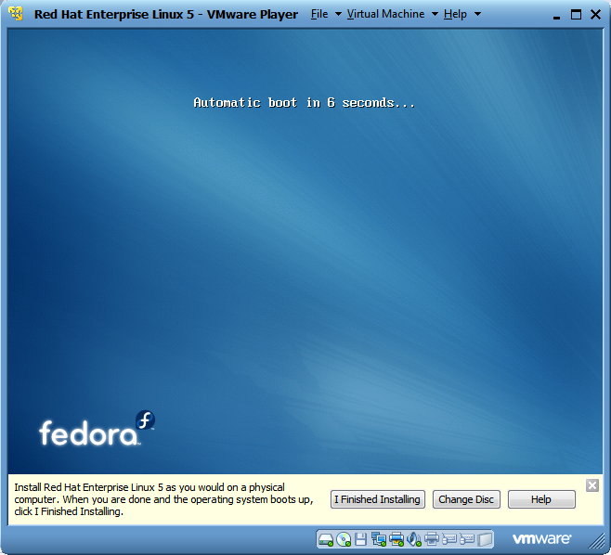
Automatic Boot

Slide 11
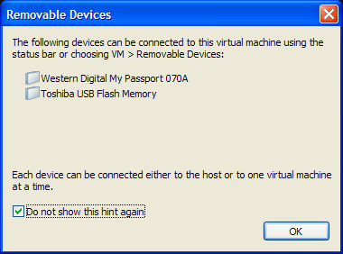
Removable Devices

Slide 12
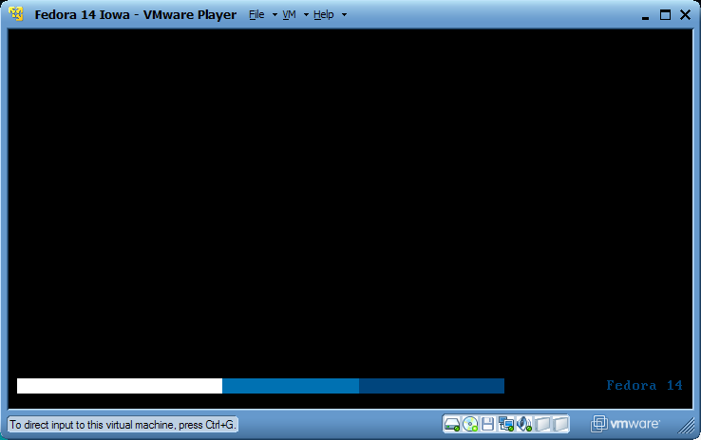
Fedora Startup

Slide 13
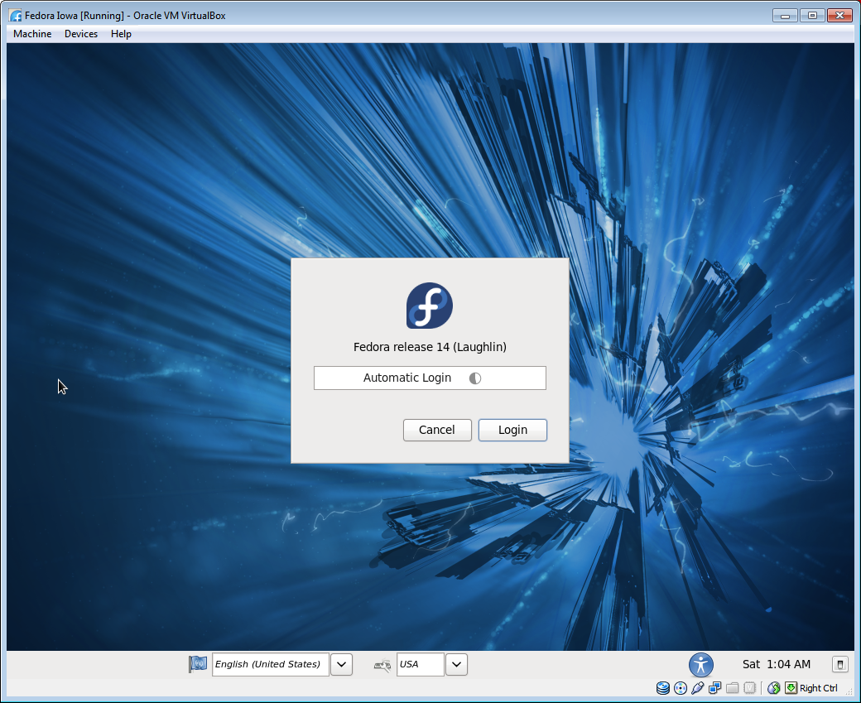
Fedora Automatic Login

Slide 14
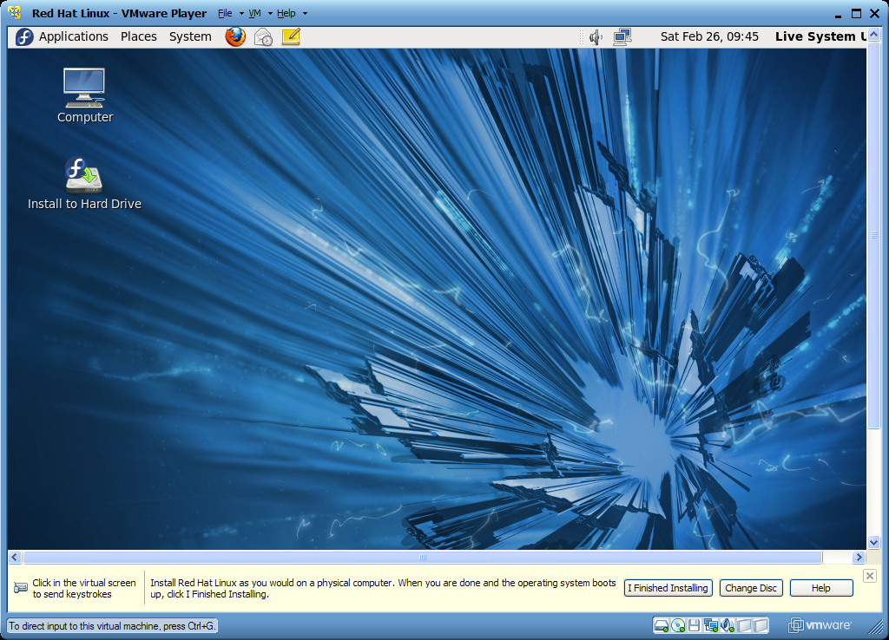
Fedora Live Desktop

Slide 15
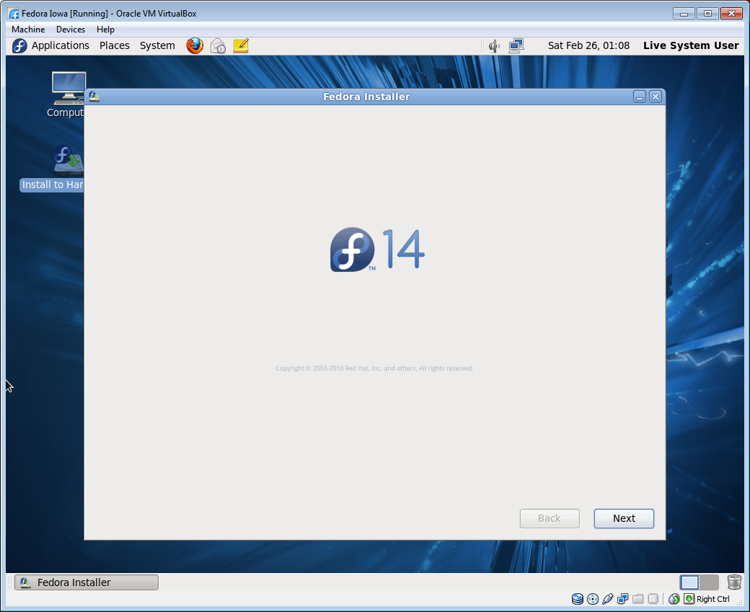
Installer Welcome Screen

Slide 16
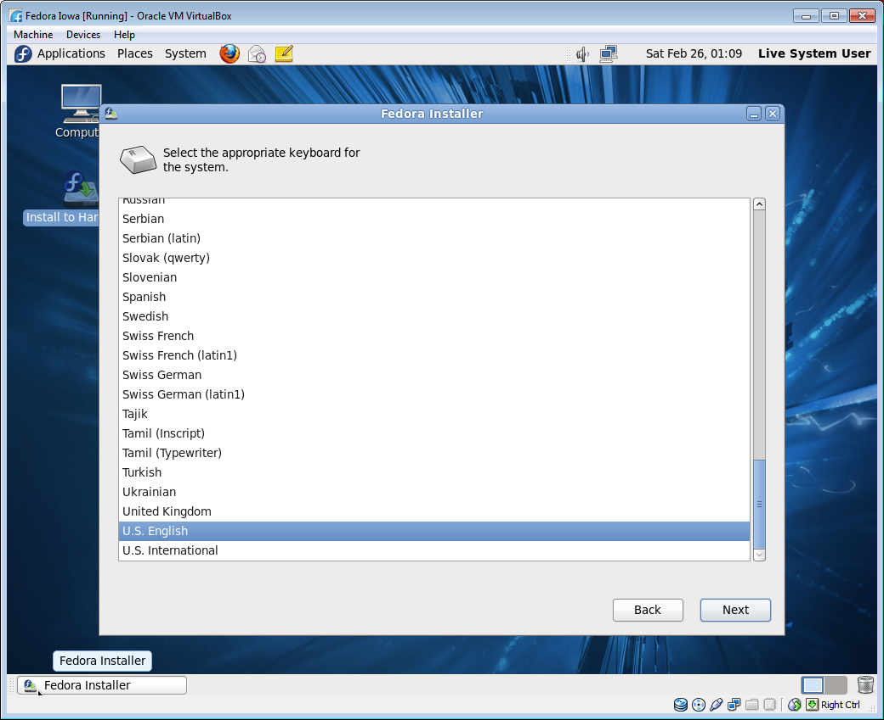
Keyboard Language

Slide 17
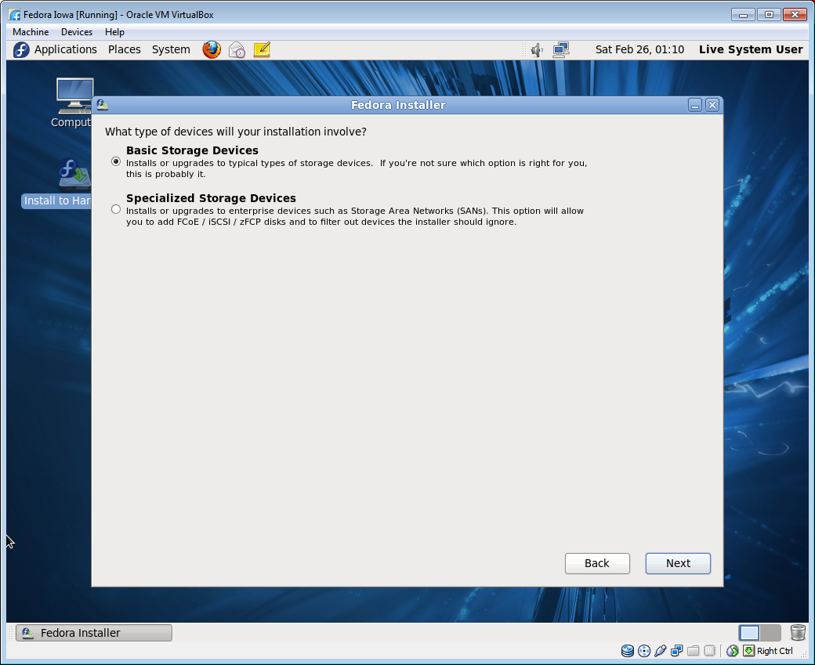
Storage Device Type

Slide 18
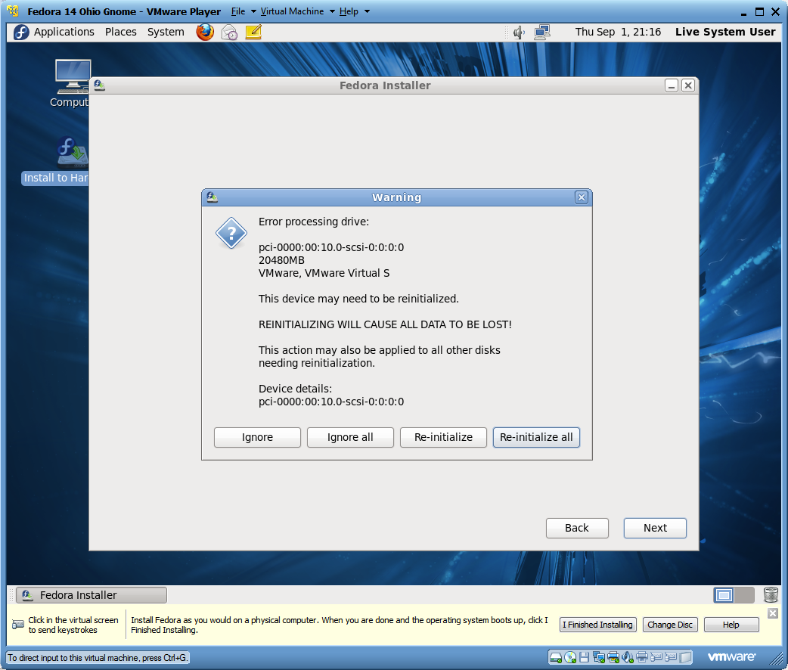
Error Processing Drive

Slide 19
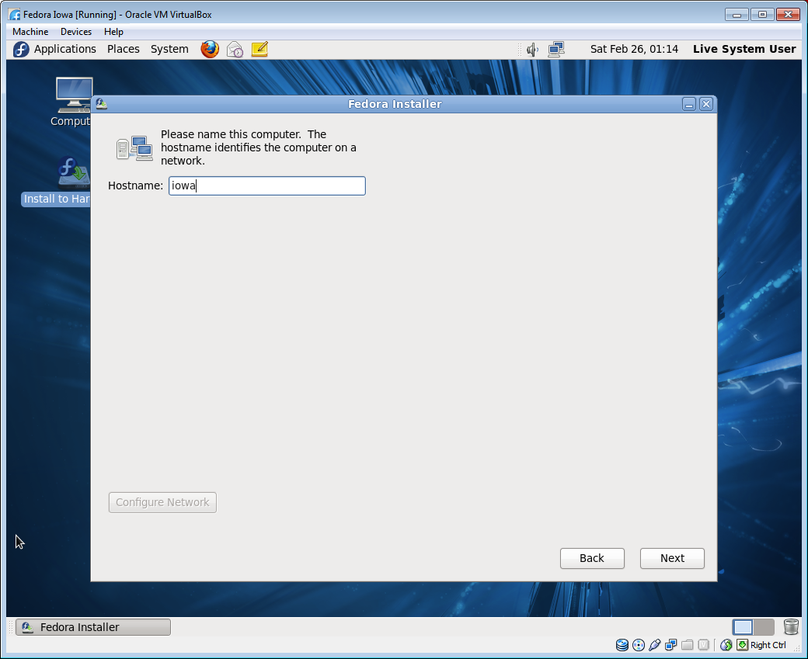
Computer Hostname

Slide 20
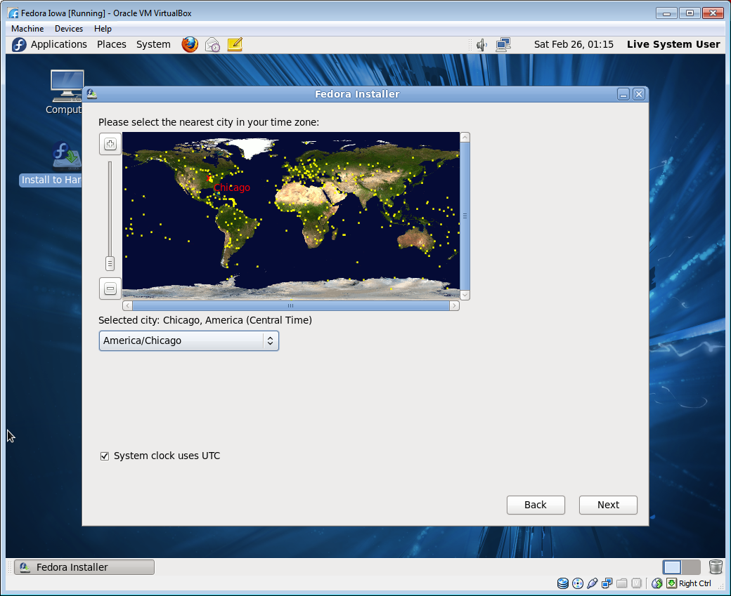
City in your Time Zone

Slide 21
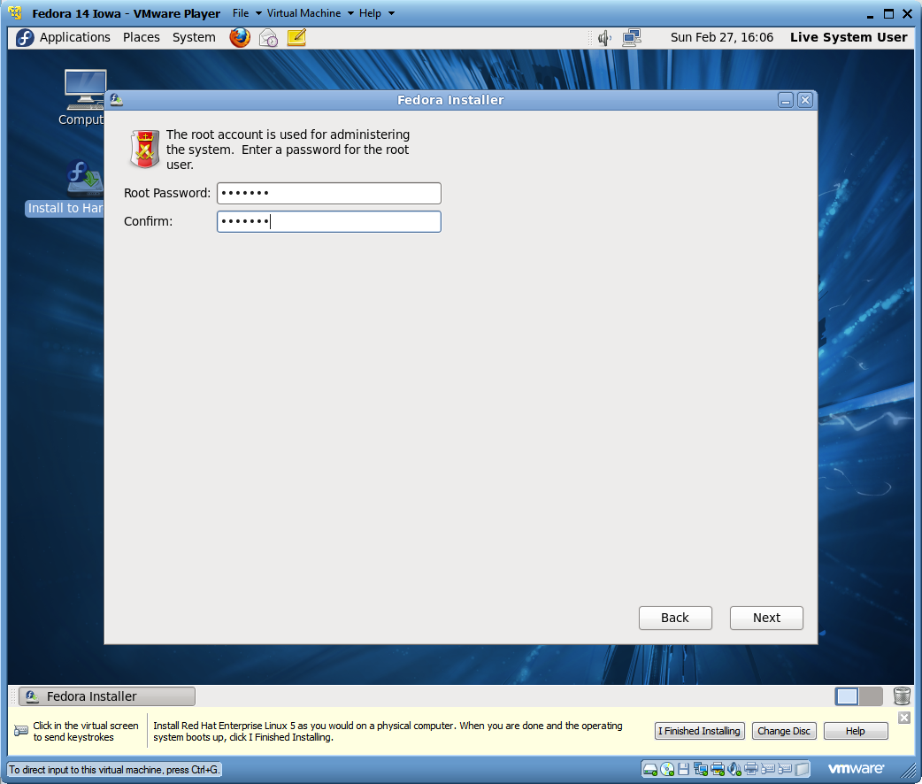
Setting Root Password

Slide 22
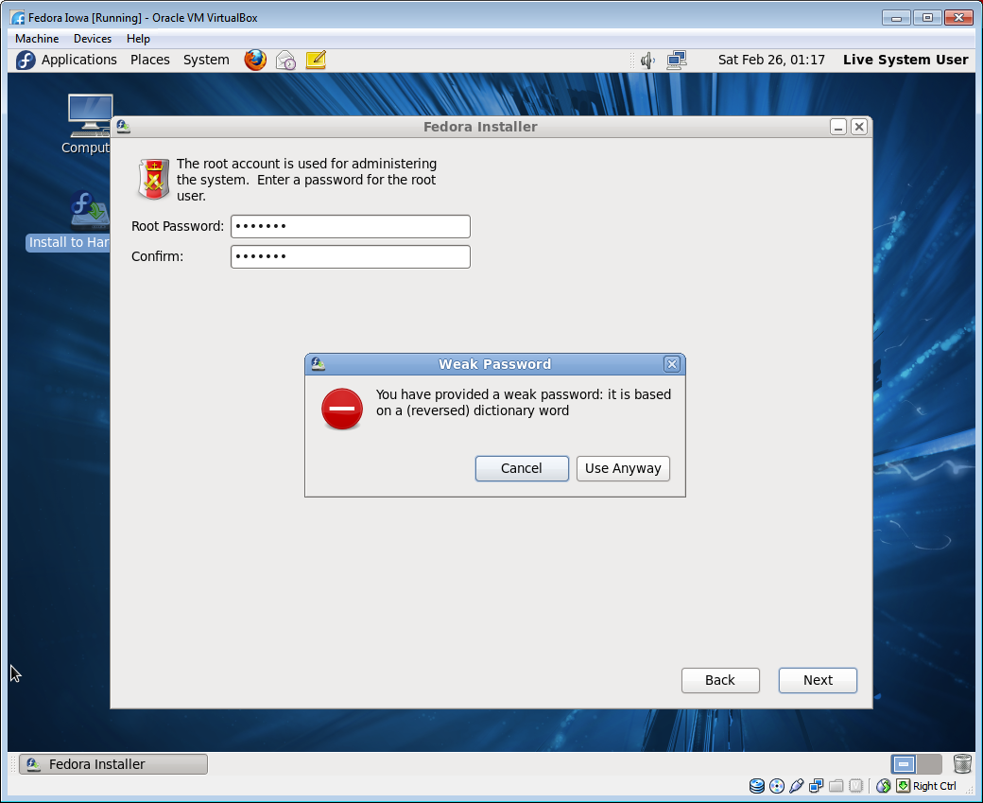
Weak Password Warning

Slide 23
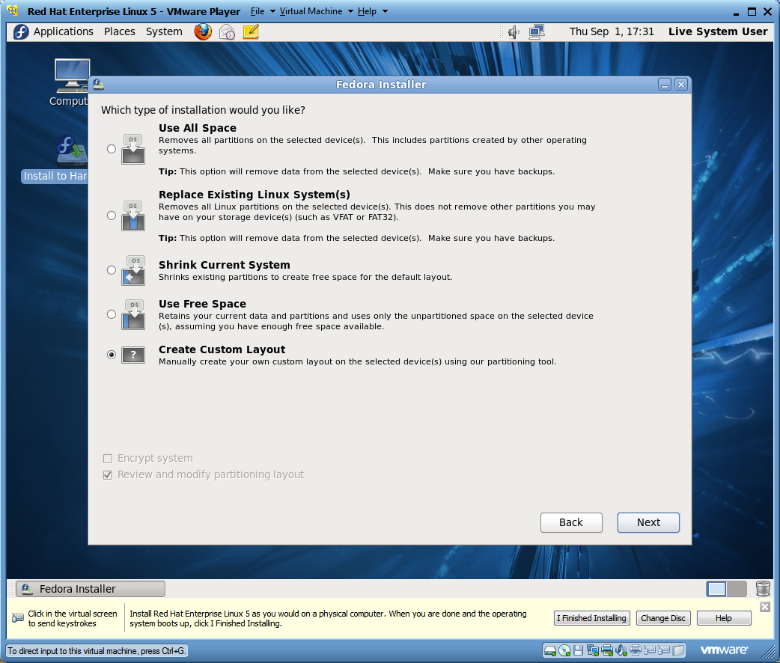
Partitioning Layout

Slide 24
Partitions
/
The slash “/” is the root partition in Linux
/boot
The boot partition is the location of the kernel used to start the operating system
/home
The home partition is the location of the user accounts
swap
The swap partition is used when memory is full
Partition | Purpose
/ | The slash “/” is the root partition in Linux
/usr | Location of executable binaries and documentation
/var | Contains spool directories for mail and printing. Also contains error logs
/tmp | Where many applications store temporary data files
/boot | Location of the kernel used to start the operating system
/home | Location of the user accounts
swap | Swap partition is used when memory is full

Slide 25
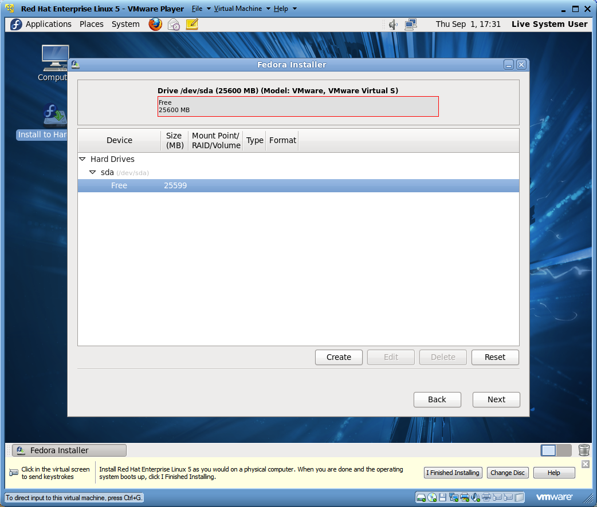
Specify Partition Sizes

Slide 26
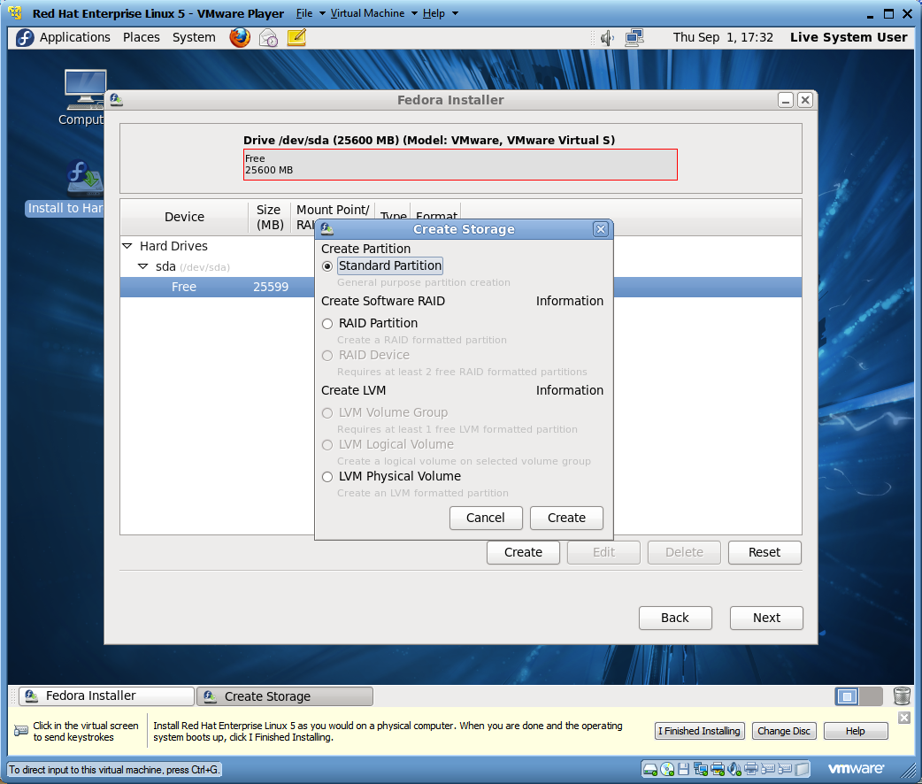
Creating a Standard Partition

Slide 27
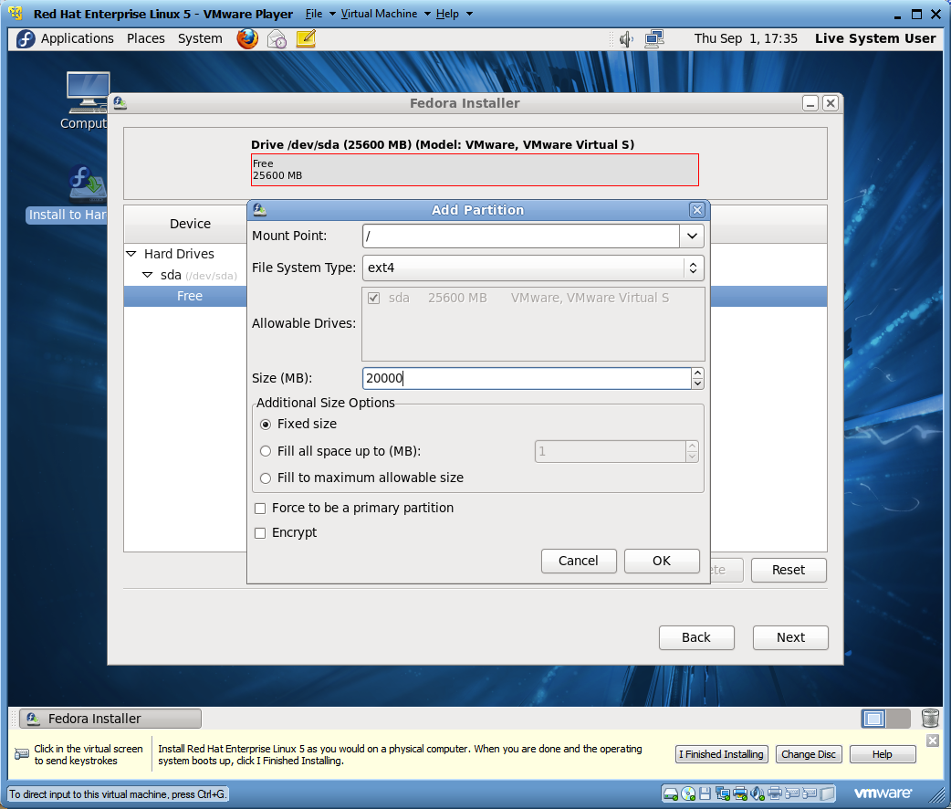
Editing the Root Partition

Slide 28
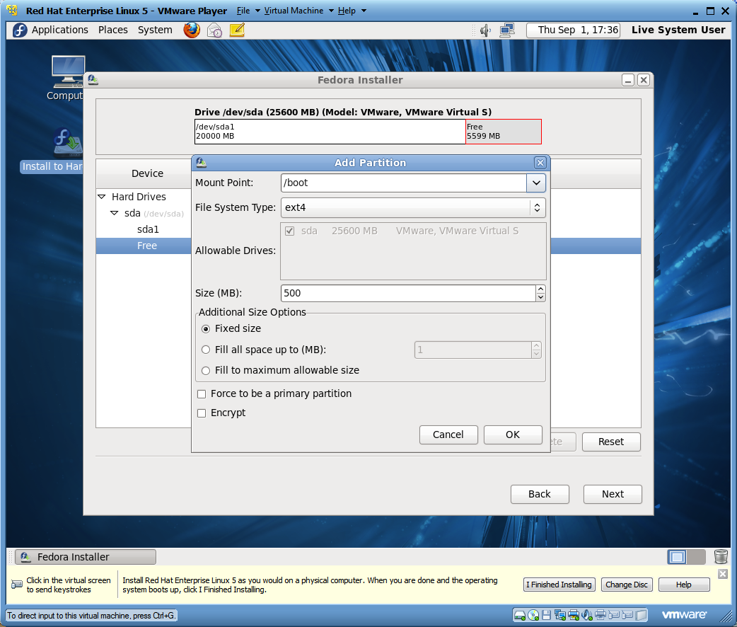
Editing the Boot Partition

Slide 29

Creating the Home Partition

Slide 30
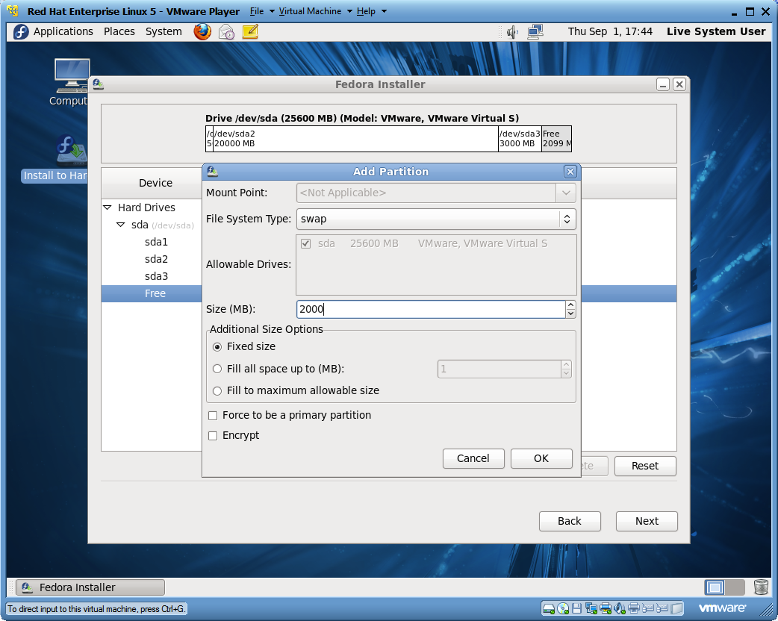
Creating a Swap Partition

Slide 31
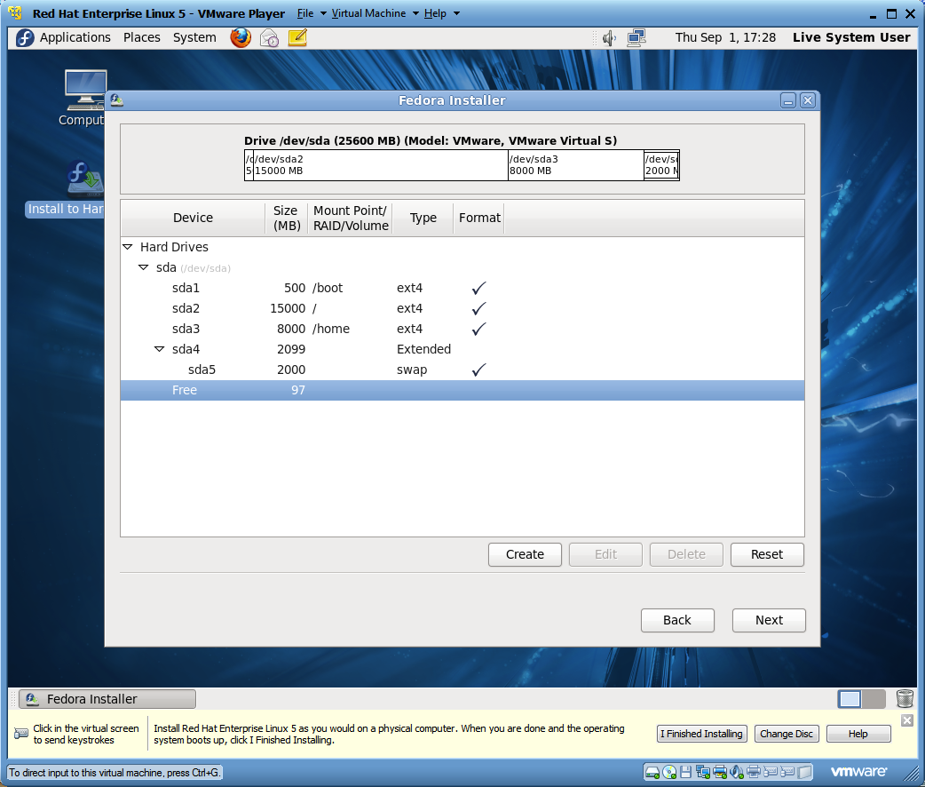
Review the Partition Layout

Slide 32
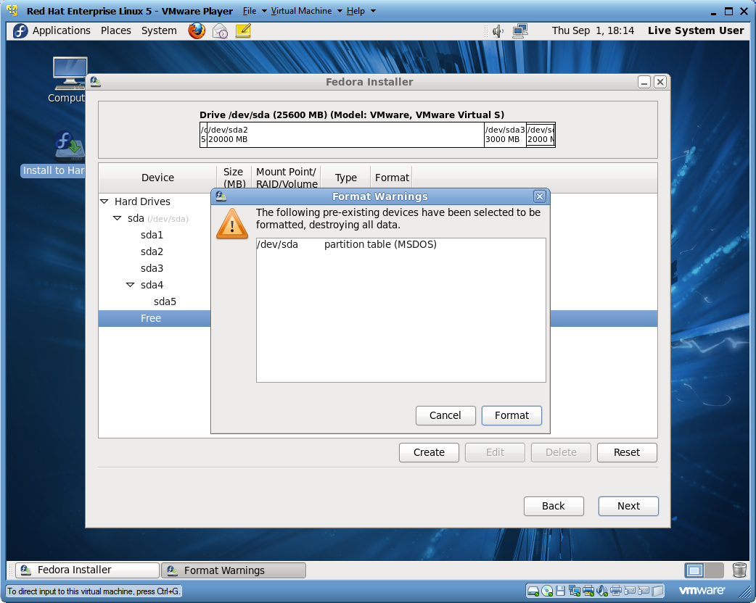
Partition Layout Warning

Slide 33
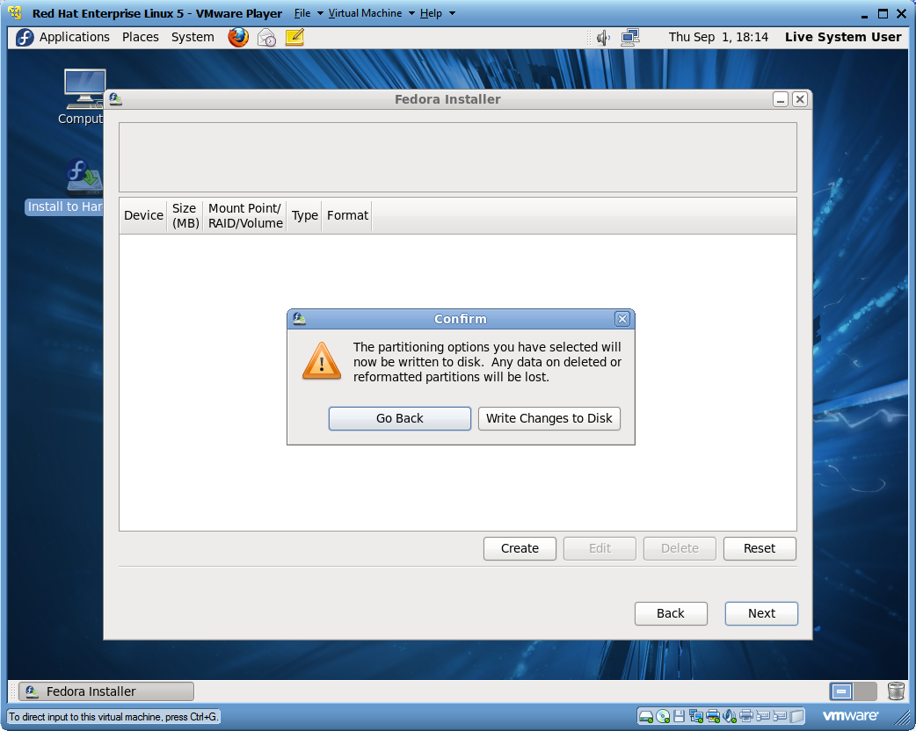
Partition Layout Confirmation

Slide 34
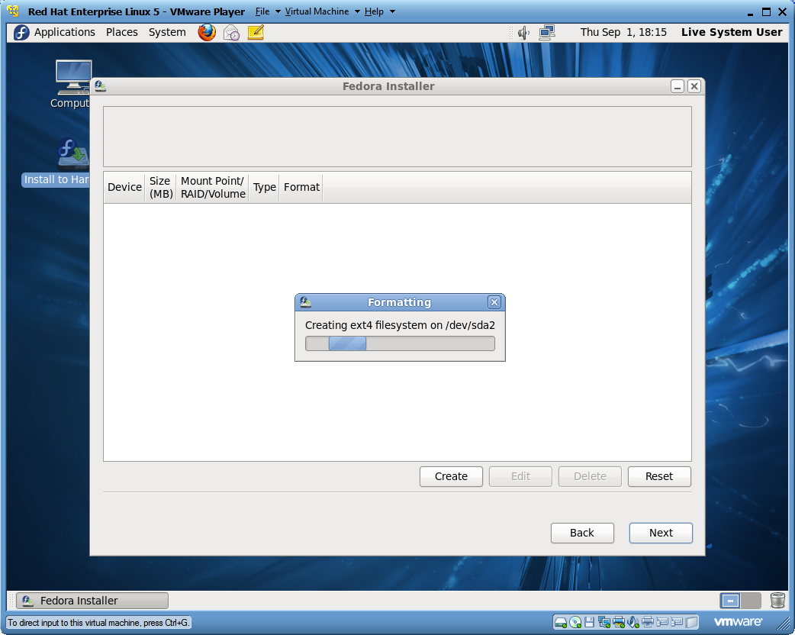
Creating the Partitions

Slide 35
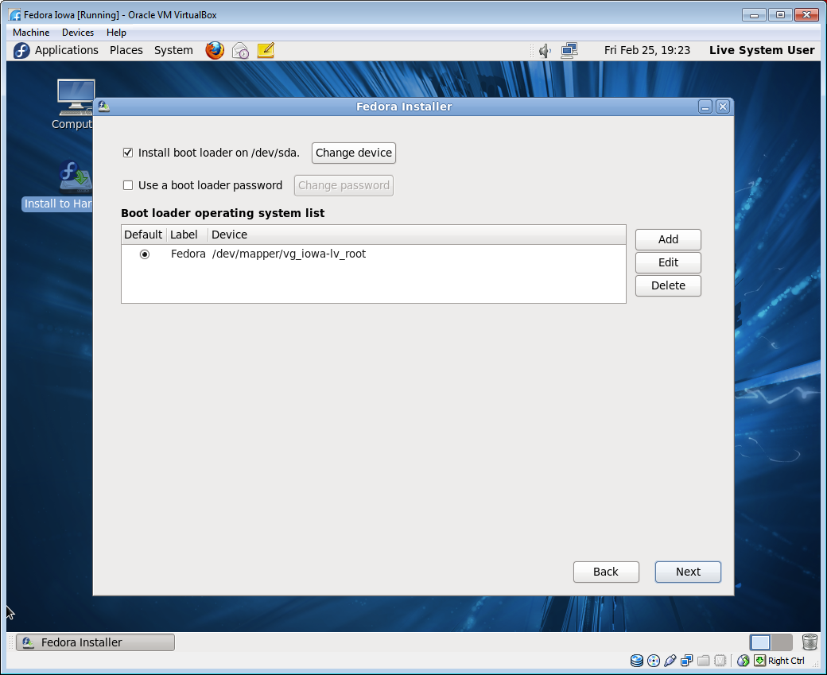
Installing the Boot Loader

Slide 36
Linux Volume Manager
After installation, the Linux Volume Manager (LVM), can be used to modify the size of a logical volume without affecting the user data.

Slide 37
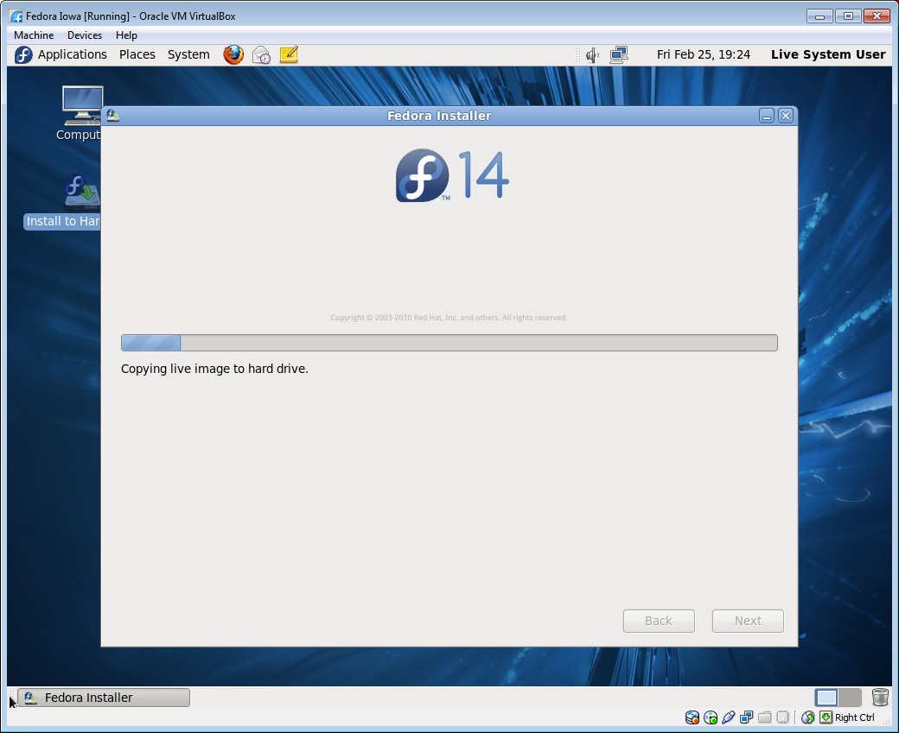
Copy Live Image to Hard Drive

Slide 38
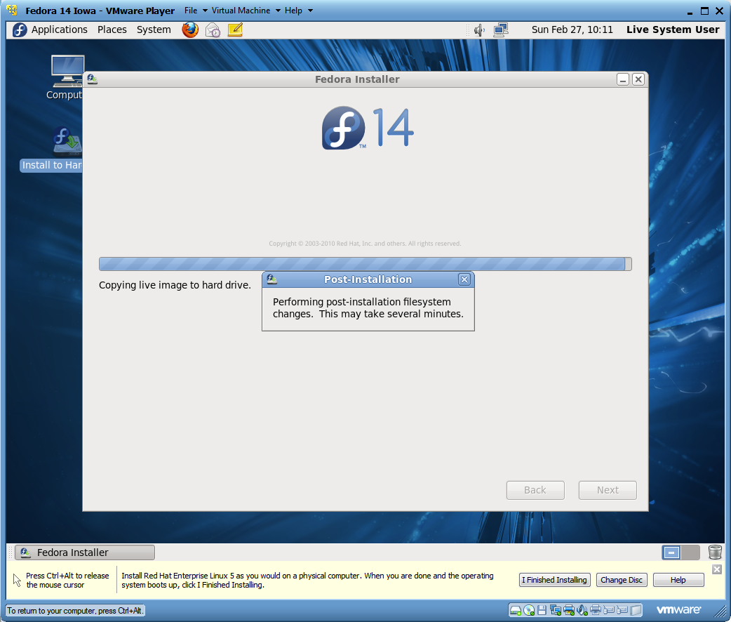
Live Image Post Installation

Slide 39
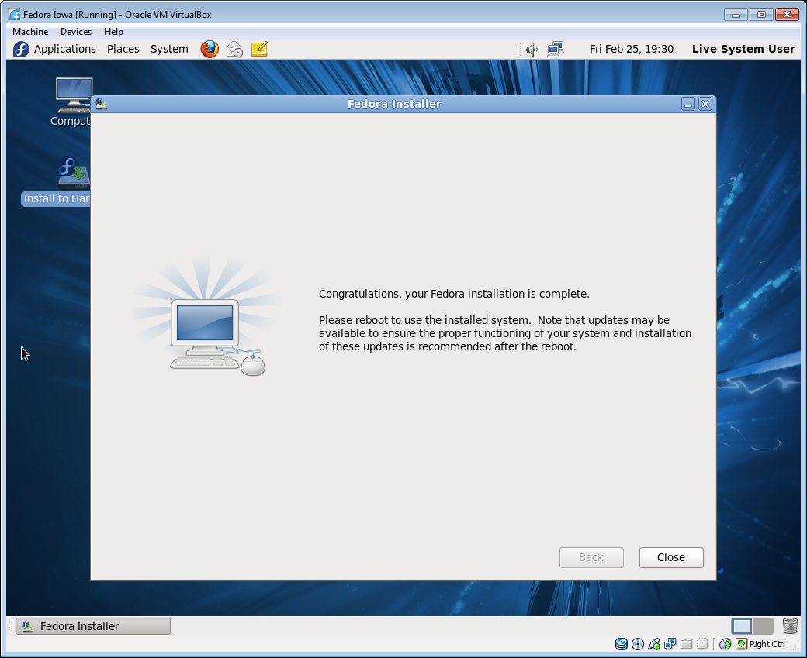
Installation Congratulations

Slide 40
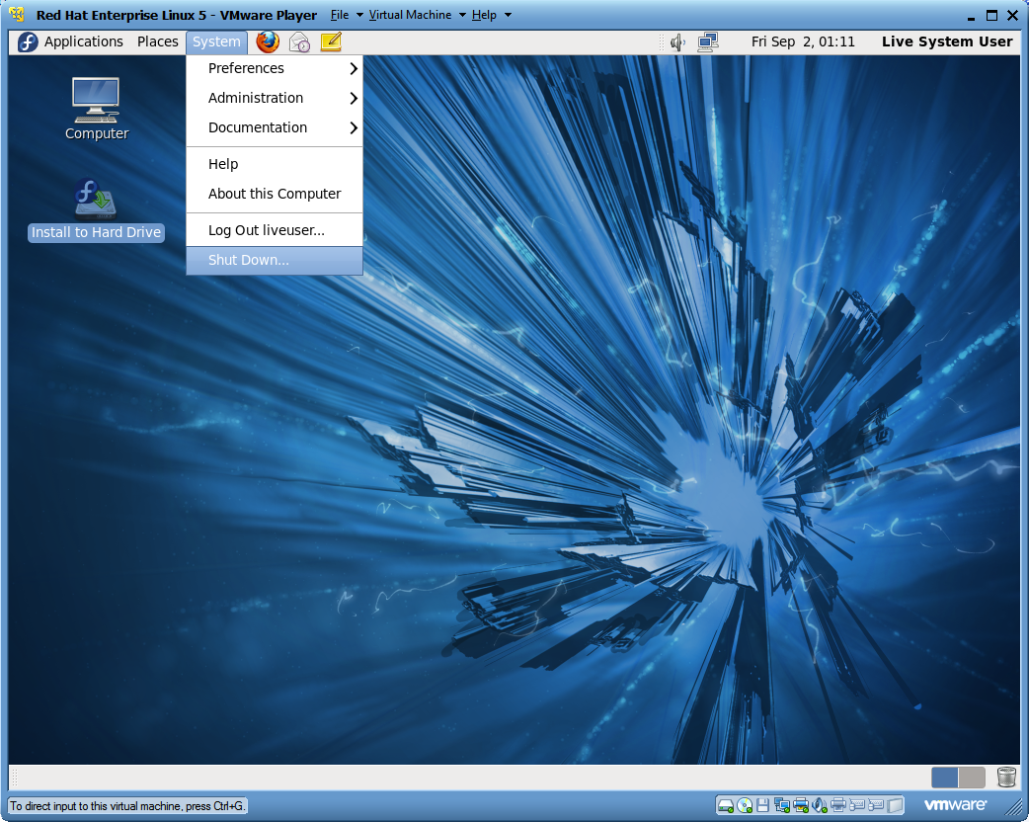
Shut Down Fedora

Slide 41
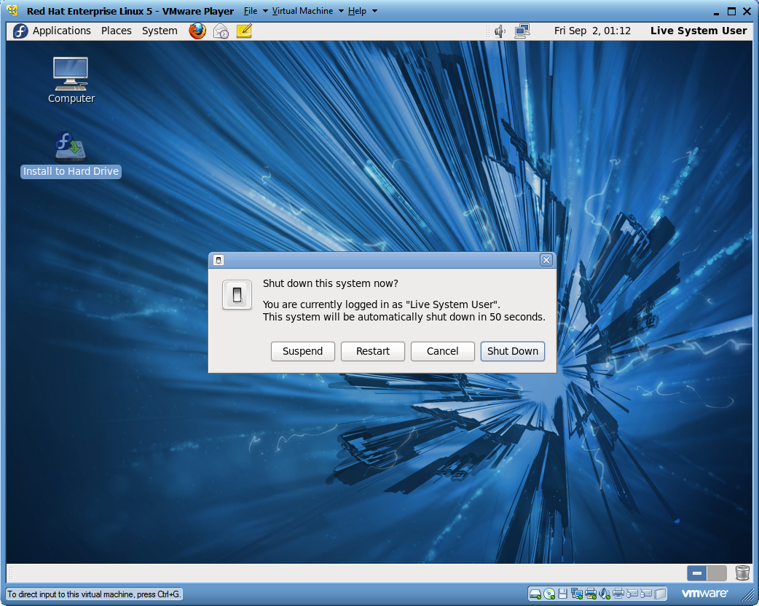
Shut Down Verification

Slide 42
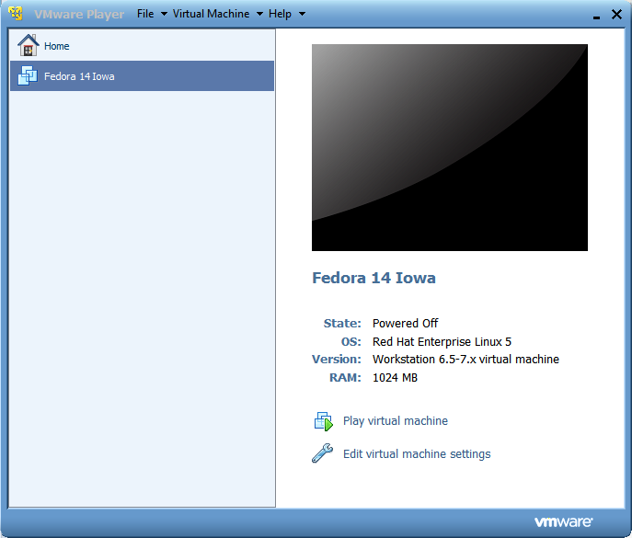
VMware Post Installation Setup

Slide 43
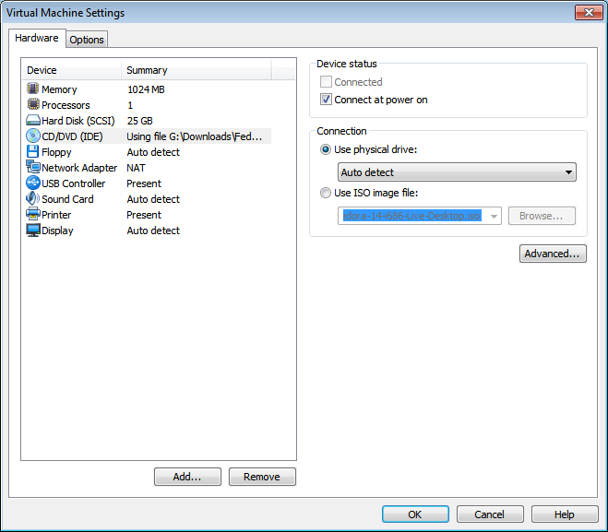
Physical Drive Connection

Slide 44
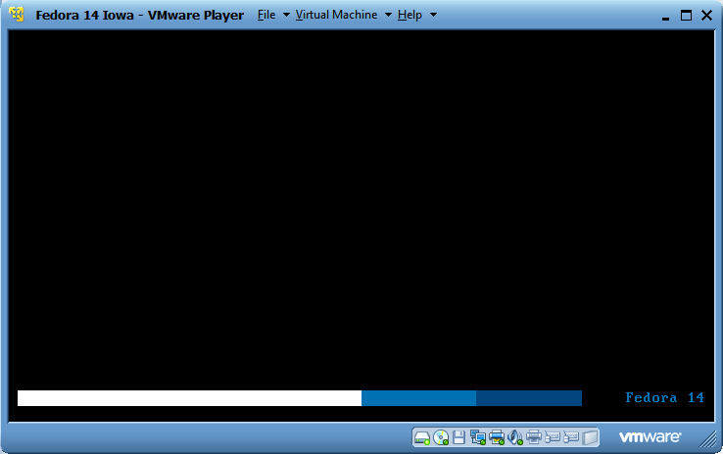
Hard Drive VMware Startup

Slide 45
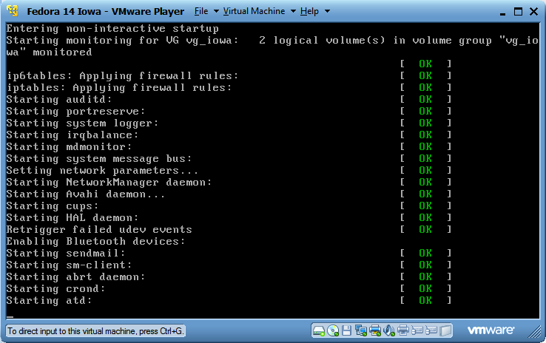
Daemon Startup

Slide 46
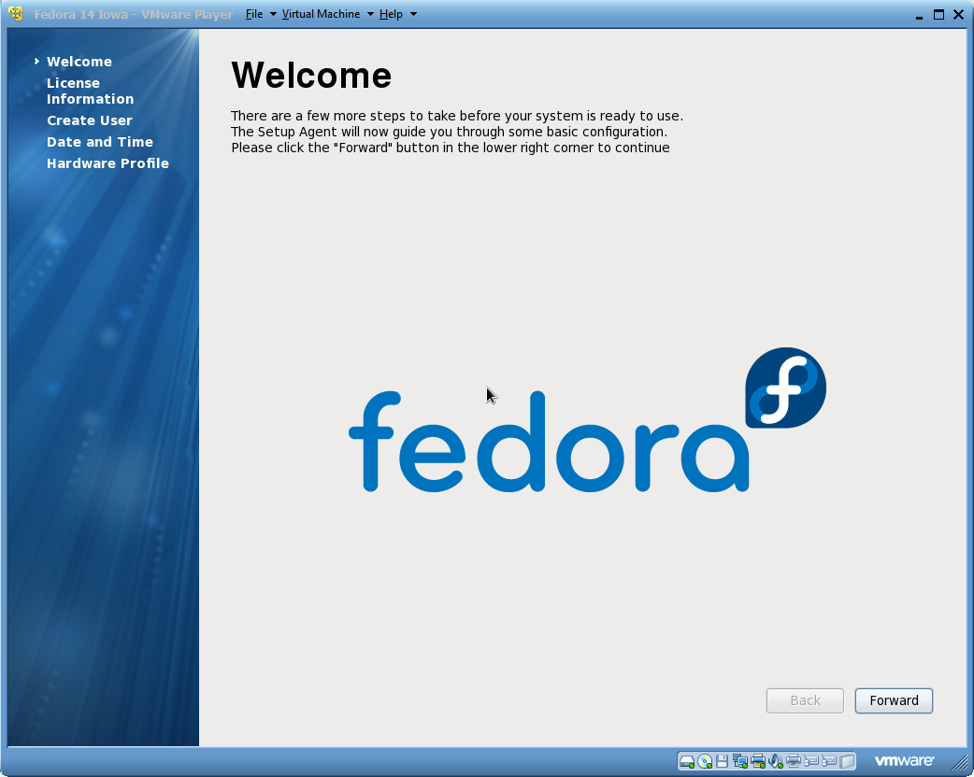
Configuration Welcome Screen

Slide 47
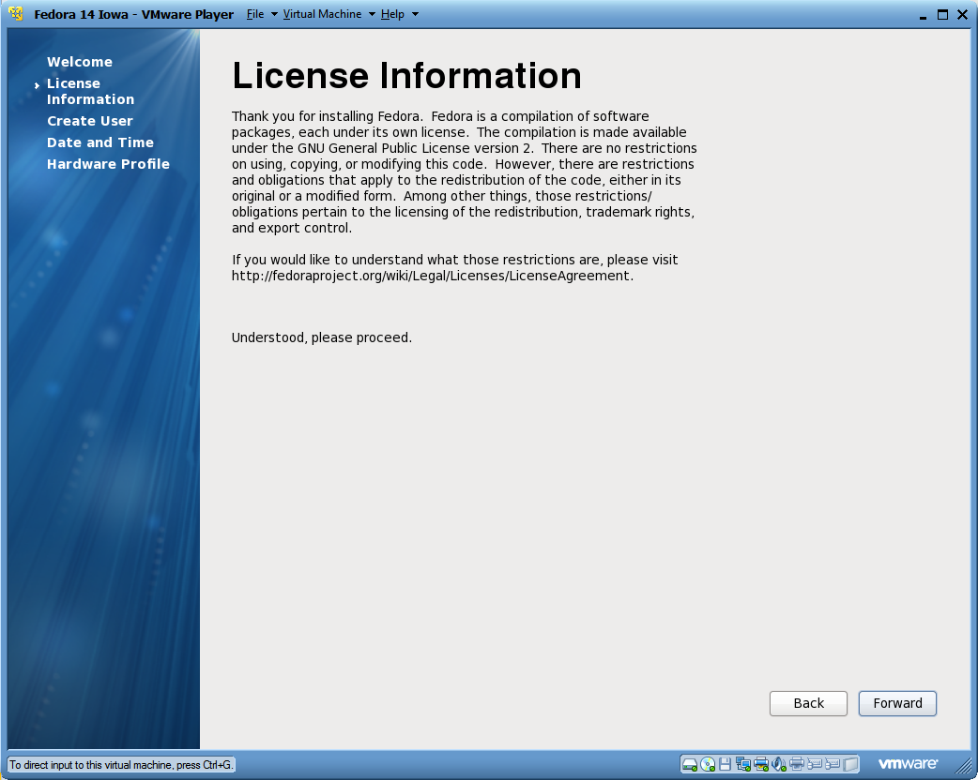
Fedora License Information

Slide 48
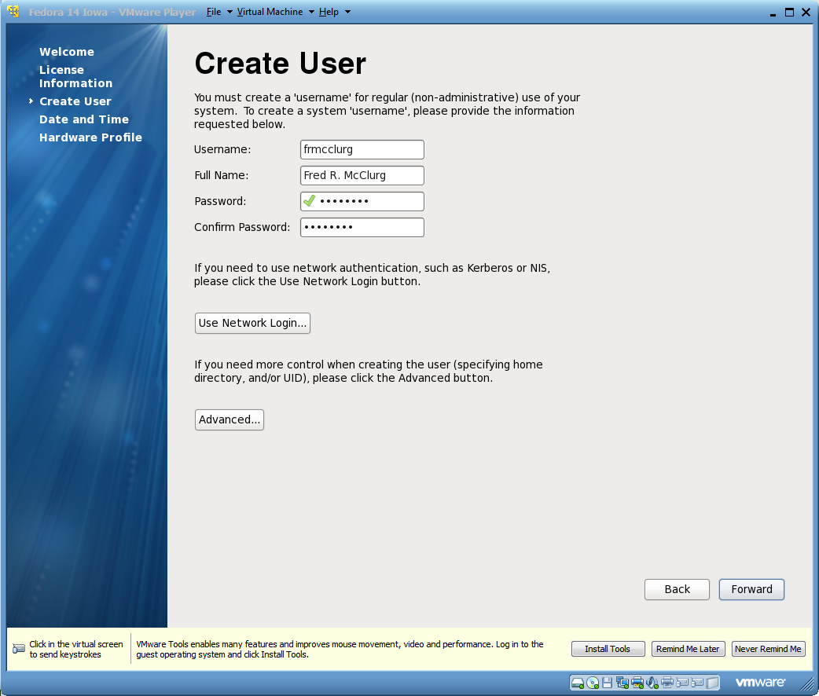
Create First User Account

Slide 49
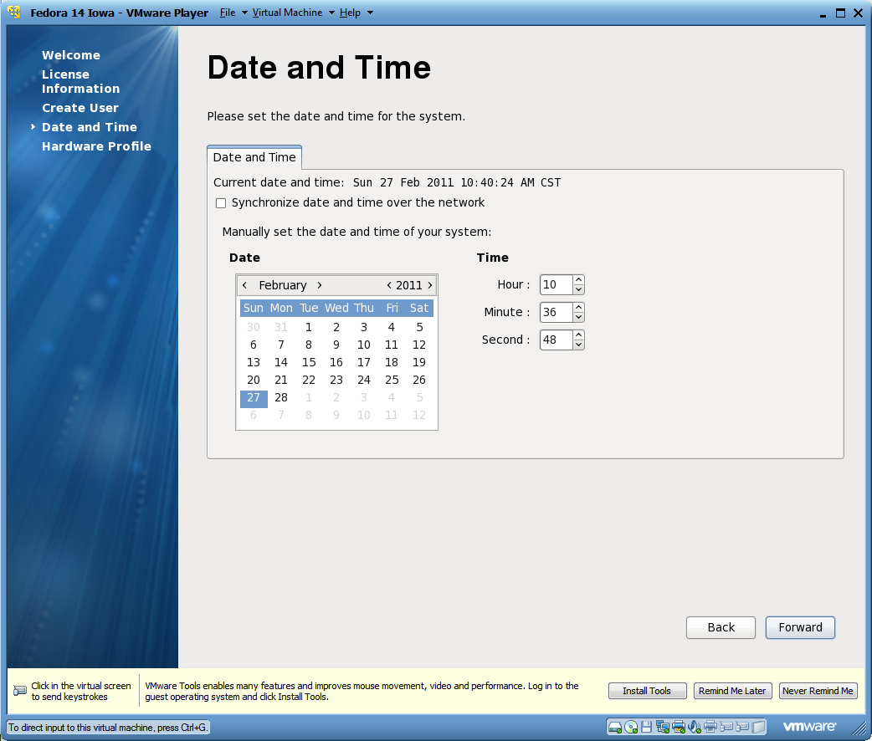
Setting the Data and Time

Slide 50
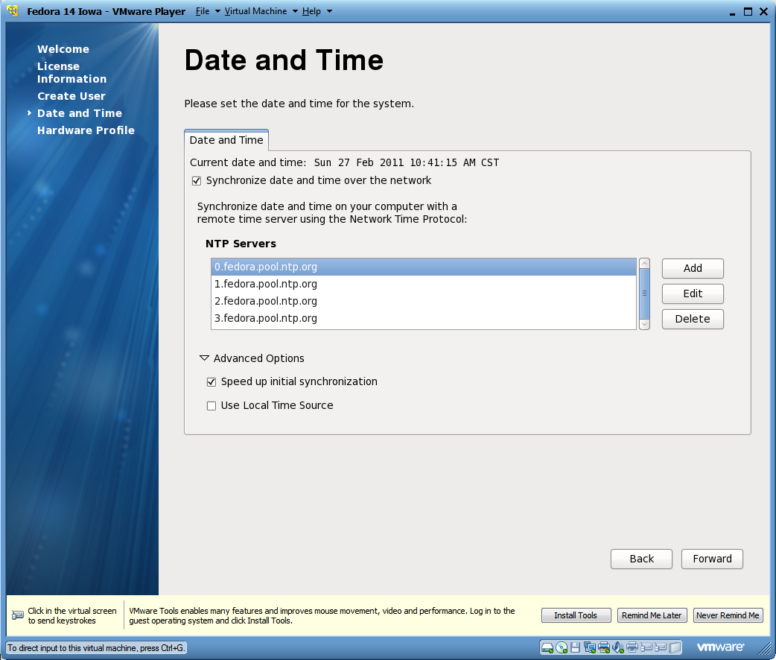
Synchronizing the Date and Time

Slide 51
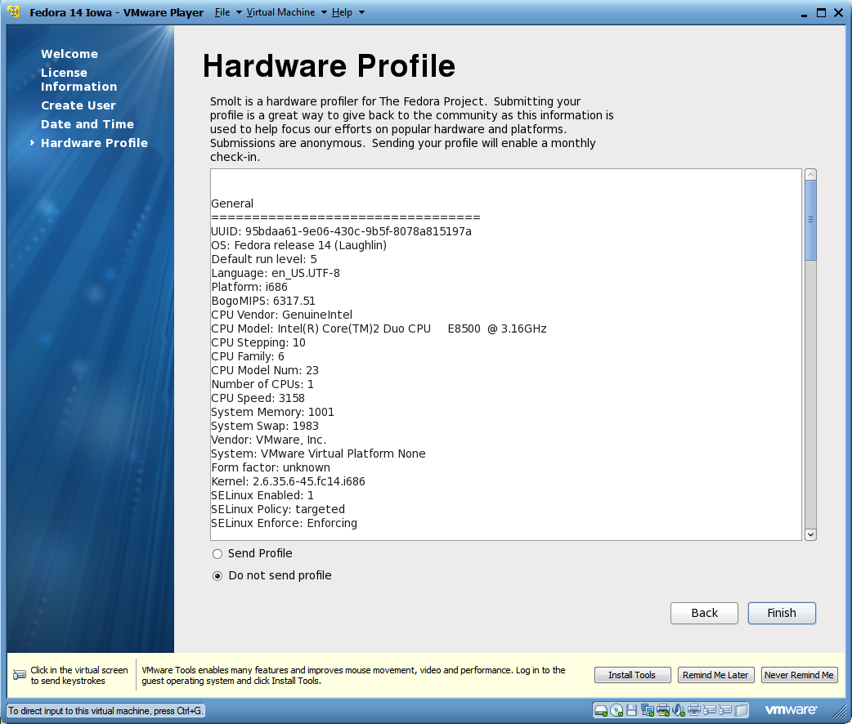
Hardware Profile Review

Slide 52
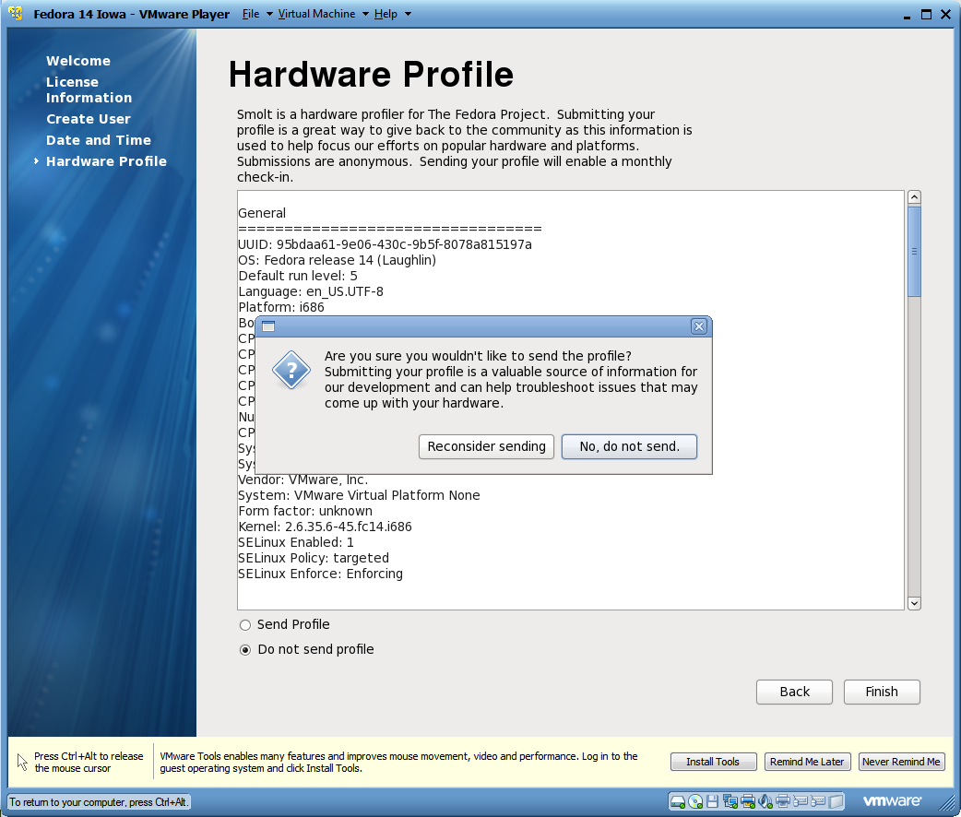
Hardware Profile Submission

Slide 53
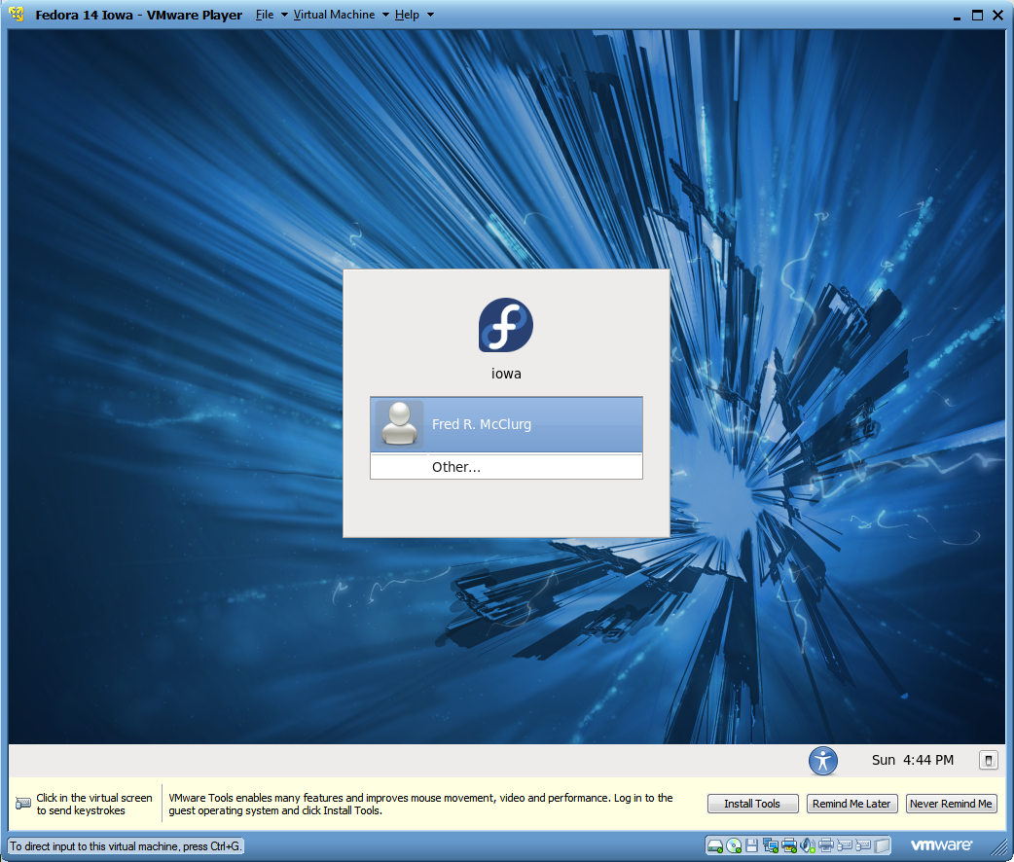
Fedora Login Screen

Slide 54
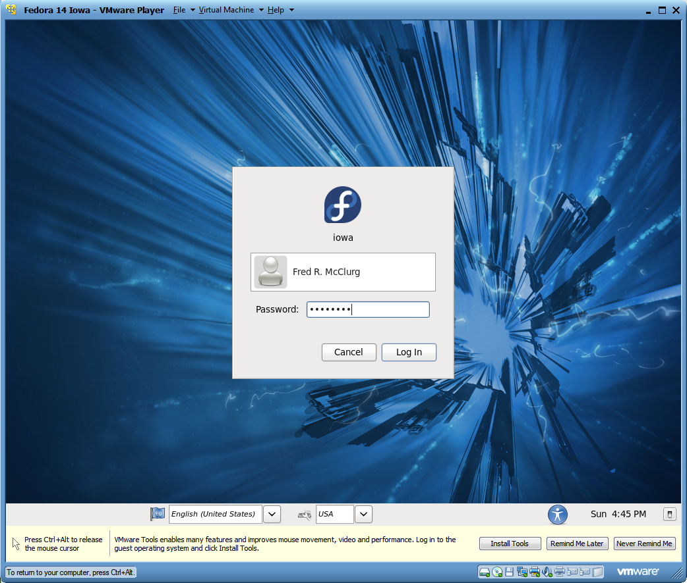
Fedora User Account Login

Slide 55

Gnome Desktop

Slide 56
Interface Customization
Q: Which component of X Windows allows customization of the user interface?
Desktop Manager
Job Control
Window Manager
Mount Point

Slide 57

Launching a Linux Terminal

Slide 58

Granting sudo user access

Slide 59

Adding user to the sudoers file

Slide 60

Software updates

